Slide 1
Marketing Analytics
Insights and Suggestions

Slide 2
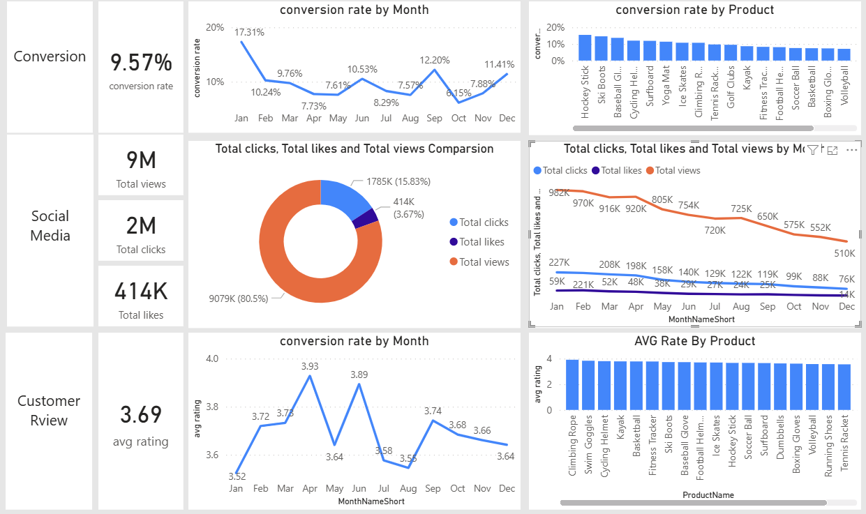
Overview page analysis
Conversion Rate Executive summary :
  The rate of change reached it’s high level in Jan at 17.31% while it’s lowest point occurred in Oct with 6.15%. The average relative rate for the year hovered between approximately 8% and 10%, with notable spikes recorded in Sep 12.20% and Dec 11.41%.
Social Media Executive summary :
  Throughout the year, social media engagement across all key metrics (Views, Clicks, and Likes) experienced a sustained downward trend. Total Views dropped by 48.1% (from 982K in January to 510K in December). Bottom-funnel engagement saw even steeper declines, with Total Clicks dropping 66.5% (227K to 76K) and Total Likes plummeting 76.3% (59K to 14K) over the same period
Customer Review Executive Summary:
  Customer rating is stable through the year averaging around 3.69.
  However the AVG rating is far aways from the goal 4, suggesting a real focus on the product that with the average rate below 3.5

Slide 3
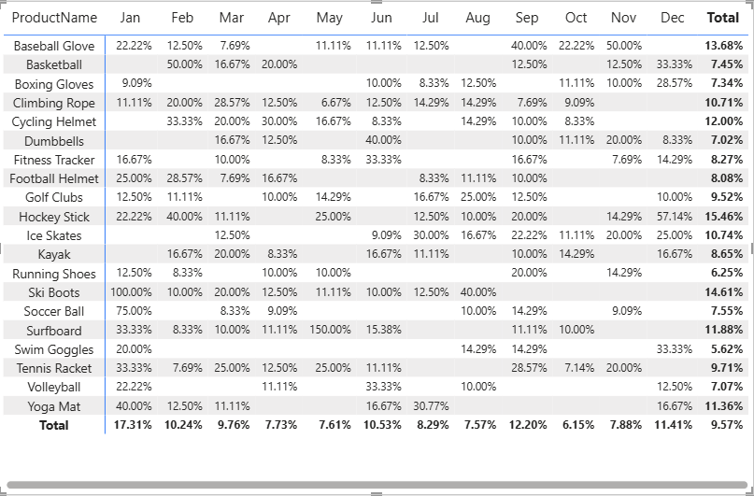
Decreased Conversion Rate
General Conversion Trend :
  Throughout the year, conversion rates varied, with higher numbers of products converting successfully in months like February and July. This suggests that while some products have strong seasonal peaks, there is potential to improve conversions in lower-performing months through targeted interventions.
Lowest Conversion Month:
  Oct experienced the lowest overall conversion rate at 4.3%, with no products standing out significantly in terms of conversion. This indicates a potential need to revisit marketing strategies or promotions during this period to boost performance.
Highest Conversion Rates:
  January recorded the highest overall conversion rate at 18.5%, driven significantly by the Ski Boots with a remarkable 150% conversion. This indicates a strong start to the year, likely fueled by seasonal demand and effective marketing strategies.

Slide 4
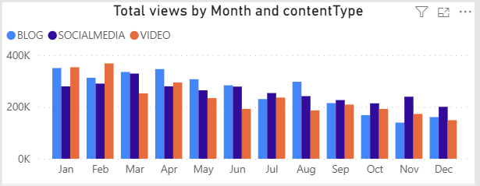
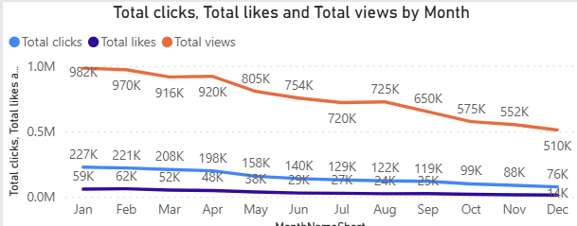
Reduced Customer Engagement
Declining Views:
  Views peaked in February and July but declined from August and on, indicating reduced audience engagement in the later half of the year.
Low Interaction Rates:
  Clicks and likes remained consistently low compared to views, suggesting the need for more engaging content or stronger calls to action.
Content Type Performance:
  Blog content drove the most views, especially in Jan and Apr, while social media and video content maintained steady but slightly lower engagement.

Slide 5
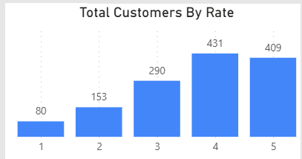
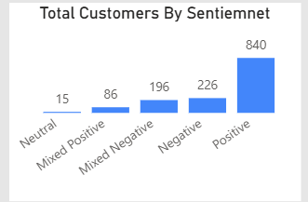
Customer Feedback Analysis
Customer Ratings Distribution:
  The majority of customer reviews are in the higher ratings, with 140 reviews at 4 stars and 135 reviews at 5 stars, indicating overall positive feedback. Lower ratings (1-2 stars) account for a smaller proportion, with 26 reviews at 1 star and 57 reviews at 2 stars.
Sentiment Analysis:
  Positive sentiment dominates with 275 reviews, reflecting a generally satisfied customer base. Negative sentiment is present in 82 reviews, with a smaller number of mixed and neutral sentiments, suggesting some areas for improvement but overall strong customer approval.
Opportunity for Improvement:
  The presence of mixed positive and mixed negative sentiments suggests that there are opportunities to convert those mixed experiences into more clearly positive ones, potentially boosting overall ratings. Addressing the specific concerns in mixed reviews could elevate customer satisfaction.

Slide 6
Goals & Actions
Goals
Actions
Increase Conversion Rates:
  Goal: Identify factors impacting the conversion rate and provide recommendations to improve it.
  Insight: Highlight key stages where visitors drop off and suggest improvements to optimize the conversion funnel.
Enhance Customer Engagement:
  Goal: Determine which types of content drive the highest engagement.
  Insight: Analyze interaction levels with different types of marketing content to inform better content strategies.
Improve Customer Feedback Scores:
  Goal: Understand common themes in customer reviews and provide actionable insights.
  Insight: Identify recurring positive and negative feedback to guide product and service improvements.
Increase Conversion Rates:
  Target High-Performing Product Categories: Focus marketing efforts on products with demonstrated high conversion rates, such as Kayaks, Ski Boots, and Baseball Gloves. Implement seasonal promotions or personalized campaigns during peak months (e.g., January and September) to capitalize on these trends.
Enhance Customer Engagement:
  Revitalize Content Strategy: To turn around declining views and low interaction rates, experiment with more engaging content formats, such as interactive videos or user-generated content. Additionally, boost engagement by optimizing call-to-action placement in social media and blog content, particularly during historically lower-engagement months (September-December).
Improve Customer Feedback Scores:
  Address Mixed and Negative Feedback: Implement a feedback loop where mixed and negative reviews are analyzed to identify common issues. Develop improvement plans to address these concerns. Consider following up with dissatisfied customers to resolve issues and encourage re-rating, aiming to move average ratings closer to the 4.0 target.

